Slide 1
Ultimate Pocket Pal Wasn’t I meant to do something today?
GitHub: https://github.com/Alexander-Perry/ultimate-pocket-pal
Deployment: https://pacific-forest-65301.herokuapp.com/
Alex Perry

Slide 2
Elevator Pitch
TODO: Elevator Pitch

Slide 3
Elevator Pitch
Are you like me and leave things until the last minute?
Did you forget about that TODO to create an Elevator Pitch?
Do you get caught up in the day to day and get stuck trying to remember what that something was you were supposed to do today?
Do you make plans and realize you’ve gone over budget?
Did you forget what you spent $50 on Monday for?
The Ultimate Pocket Pal is here to help!

Slide 4
Concept
Description
Ultimate Pocket Pal is a functional, easy to use application that allows a user to Add daily events and tasks for each day of the week and assign a cost to each event. It allows a weekly budget calculation that helps the user work out whether they can afford to head out to that concert, to go to the pub for drinks, to spend that extra $50 on a birthday present, or simply how much you can spend on groceries.
Motivation
I’m not exactly the most organized person. I have a tendancy to leave things until the last moment, to get to the end of the day and think ‘I was supposed to do something today…’ I lose track of my spending. I remember back in the 90s where digital organisers were the in-thing, and this got me thinking of a simplistic way of keeping myself organized.

Slide 5
User Story
AS Someone who struggles with keeping organized and on top of tasks
I WANT an application that provides easy-to-use personal event, task and budget management
SO THAT I can better organize myself, to keep track of things that I have on each week and provide simple approach to budgeting.

Slide 6
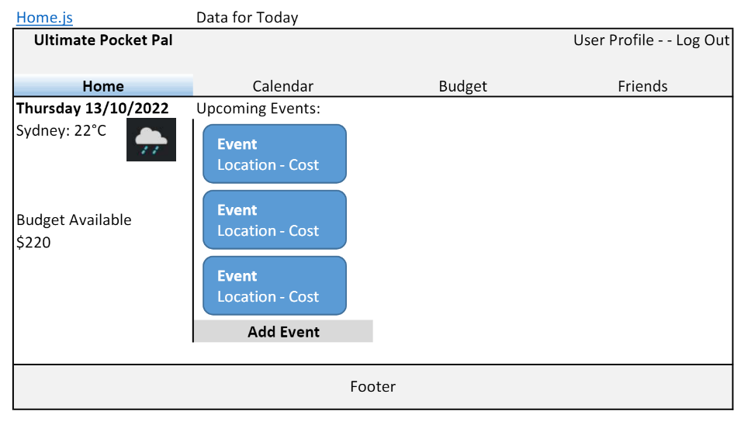
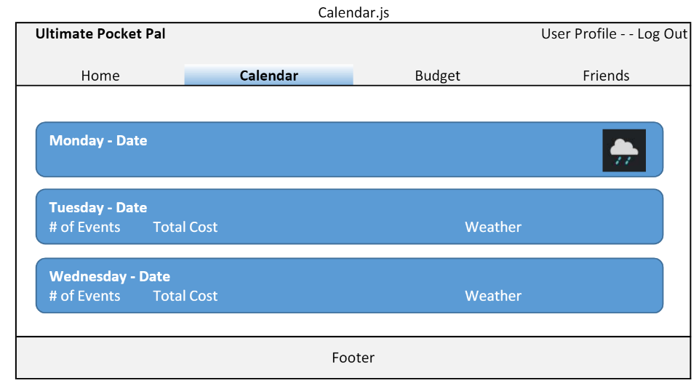
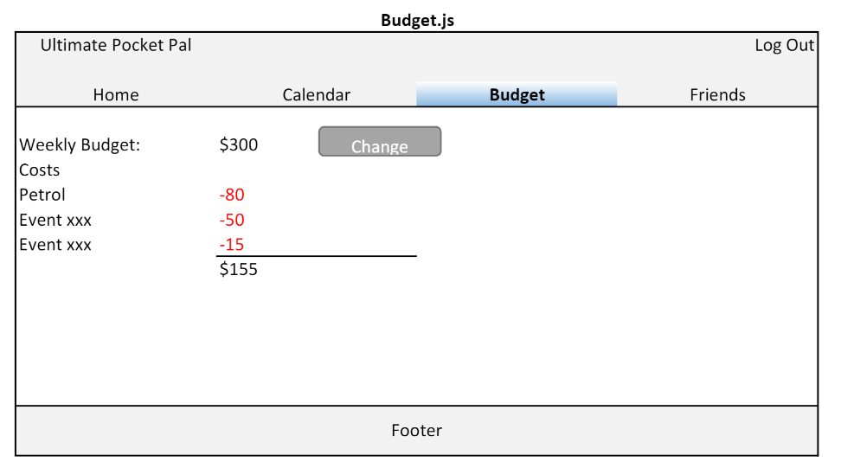
Concept - Wireframes

Slide 7



Process
Technologies Used:
React
MongoDB
Mongoose
MUI (Material UI) component Library
MUI Theme Creator (https://bareynol.github.io/mui-theme-creator/)
Node + Express
JWT

Slide 8
Challenges and Successes
My Original Project Idea and biting off more than I could chew.
My Original idea for the application as a fully functional calendar, with day/time breakdowns of events and plans, an included Friends list with the ability to Invite users to events through the platform, as well as including geolocation on the events and weather forecast, was a little too ambitious given the time-constraints, but see Future Plans!
Mixing up MERN/REST
After creating the REACT app, building the front-end and getting the rendering functional, I completely forgot about building the actual back-end/server side.
Material UI
The documentation for MUI I found isn’t exactly the best, and I found myself doing a lot of google research on just how to incorporate the components
Heroku Deployment
Setting up Atlas and the Heroku environmental variables was interesting

Slide 9
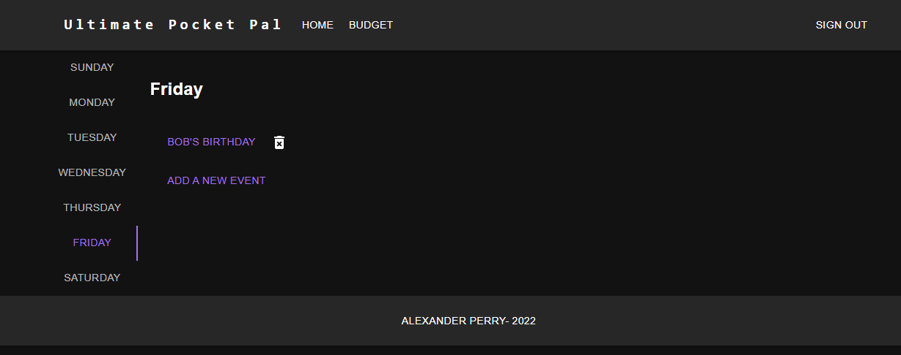
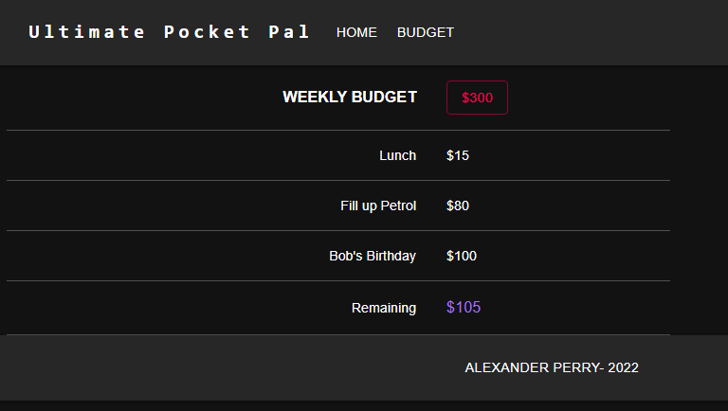
Demo:

Slide 10
Future Plans!
Friend List Invite friends to created events, display attendees on events, as well as internal messaging.
User Profile Including contact information, city location
Calendar Expand to include time blocks, and a wider range of periods
Budget Expand to include historical views and budget calculations over greater time-spans
Locations (geocoding) for Events to include searchable addresses and locations that display a location map when clicked
Weather forecast and information
More Views Homepage displaying Today’s information and upcoming events

Slide 11
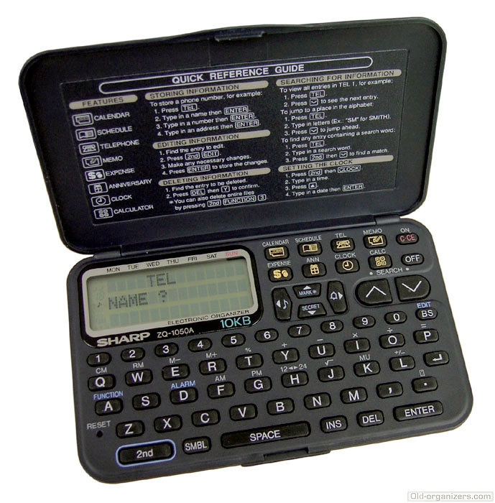
Inspired by 90’s Nostalgia
Image courtesy of https://old-organizers.com/

Slide 12
GitHub: https://github.com/Alexander-Perry/ultimate-pocket-pal
Deployment: https://pacific-forest-65301.herokuapp.com/

